Slide 1
WHO response to the results of the Evidence for Contraceptive Options and HIV Outcomes (ECHO) study Rethinking HIV programmes in context of the results
Rachel Baggaley, Michelle Rodolph, Shona Dalal
@WHO
Share your thoughts on this presentation with #IAS2019

Slide 2
Rethinking HIV programmes in context of the ECHO results
Understanding the implication of the ECHO data
Offering HIV testing
Offering HIV prevention options and PrEP
Considering STI management, CxCa screening
Prioritization

Slide 3
1. Understanding the implication of the ECHO data for HIV prevention
Women in the ECHO trial
“Women recruited in ECHO based on geography, but not on any other characteristic of HIV risk, eg transactional sex, history of STIs, self-reported higher-risk behaviours”
16-35 years
80% never married
75% secondary school
48.3% reported no condom use with last sex act
6.8% reported >1 partner in last 3 months
STIs were common
18·2% C. trachomatis
4·7% N. gonorrhoeae
38·2% HSV-2
Not all women in ECHO are the same and have the same HIV risk
Women had greater HIV risk in ECHO if:
<24 years
>1 sexual partner in last 3 months
STIs including HSV-2 serology

Slide 4
Overall in ECHO
For women seeking contraception in HIV high burden settings the overall observed incidence in ECHO was 3.8% per year
Shockingly high incidence overall, but interpret with caution
10 fold difference in country/site incidence (South Africa 3->6%) - Lusaka, Zambia >1%
Sites were chosen, specifically, because of anticipated high incidence
May not represent national or even sub national picture
Need to consider a nuanced approach, especially for lower prevalence countries

Slide 5
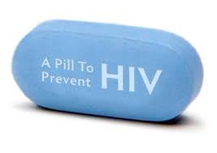
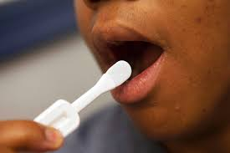
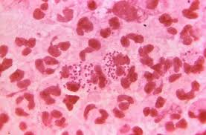
But generally…. Need better HIV testing & prevention in contraceptive services
Overcome barriers in FP clinics to discuss HIV and offer risk assessment and counselling
All women
voluntary partner testing service
condoms
STI services
IPV
Women with HIV
linkage to ART
HIV negative women
PrEP
HIV testing
Inc HIVST

Slide 6
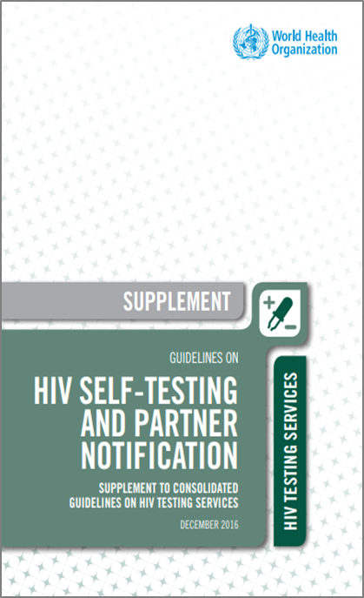
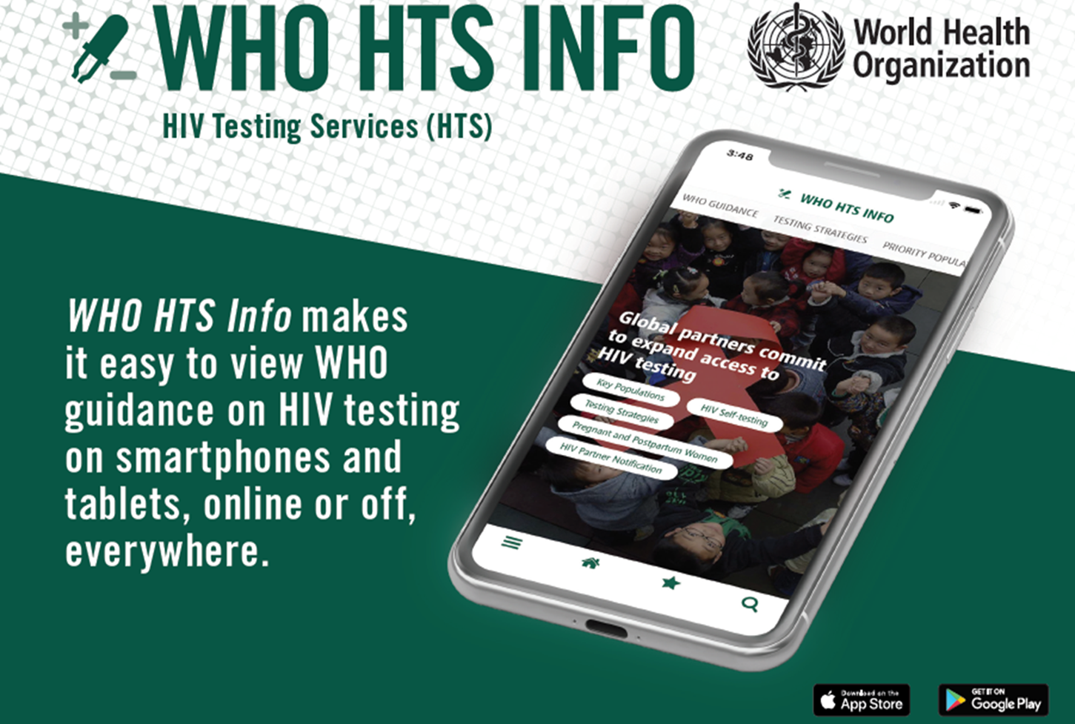
2. HIV testing
New testing approaches provide additional benefits and opportunities
HIV self-testing
Assisted partner notification services
HIV testing highly acceptable in clinical settings
Routine offer in ANC
High uptake (often <95%)
Immediate linkage to ART

Slide 7
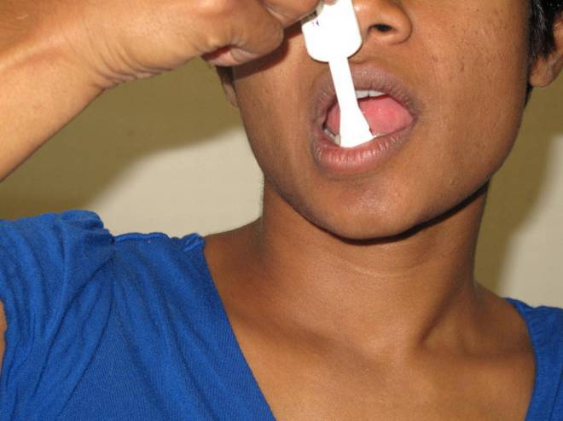
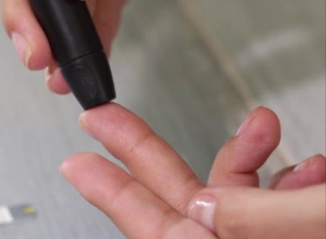
HIV self-testing
WHO recommends HIVST
Safe and accurate
Highly acceptable
Increased access
Increased uptake and frequency of HIV testing among those at high risk and who may not test otherwise
Identified more HIV+ people
Empowering
Cost-effective when focused
As of July 2019, 3 HIVST kits are WHO prequalified (1 oral fluid, 2 blood-based)

Slide 8
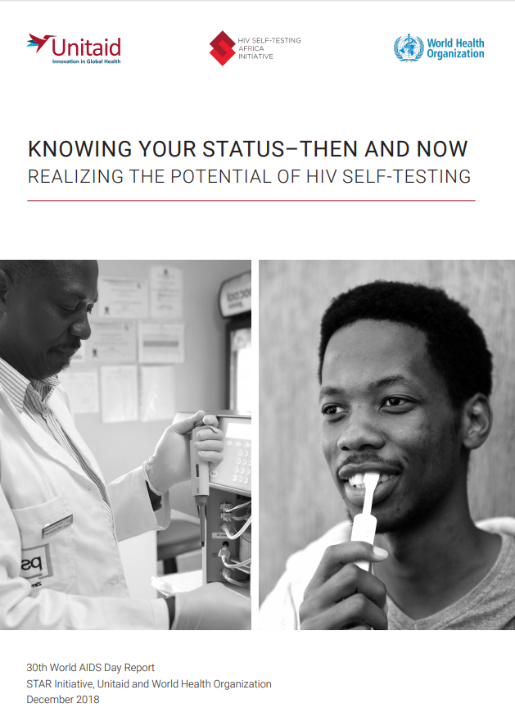
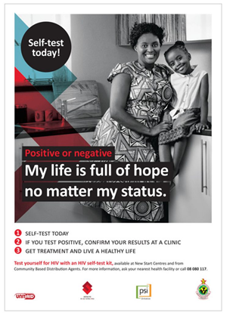
HIV Self-testing ? Ideal for contraceptive service settings
The policy environment is right
HIVST increasingly being included in national policies and programme
HIVST kits available in many high burden countries in ESA
HIVST included in GF and PEPFAR programmes
HIVST can be offered while waiting for services
Reduces problems with misdiagnosis inc sample mix-ups
Allows testing to be linked to post test counselling and support
Facilitates immediate confirmations and linkage for women with + results
Reduces opportunity costs for clients
National HIVST policy and implementation 2018
Globally,
40% (77/194) reporting countries have HIVST policies,
of these only 49% (38) are implementing
Community engagement is key
Listed to community concerns
WHO has held numerous community consultations prior to implementations

Slide 9
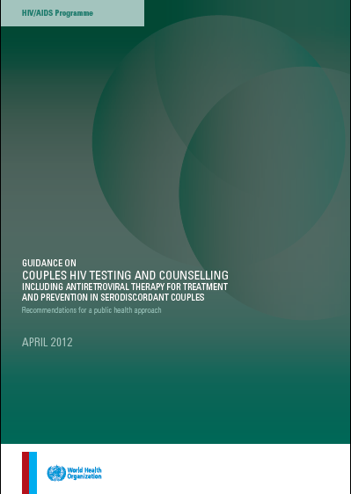
2. Testing for partner and couples WHO CHTC guidelines – 2012
There are multiple benefits for greater sharing of HIV status and couples testing together
WHO strongly recommends couples testing & counselling in all settings, including FP and ANC clinics
CHTC with mutual disclosure should be offered to individuals of known HIV status
Strong for HIV+ individuals; Conditional for HIV- individuals depending on population HIV prevalence
WHO recommends ART for prevention in serodiscordant couples – irrespective of CD4 count – the first formal WHO TasP guidance
http://www.who.int/hiv/pub/guidelines/9789241501972/en/index.html.
Notes:
WHO had nearly finished its work on developing its CHTC guidelines when these results from HPTN052 were released – they strengthened our recommendation to support the offering of ART not only for health benefits but for prevention of HIV transmission in serodiscordant couples.
These guidelines were released by WHO in April this year and countries are beginning to include prioritizing CHTC in their programmes and consider recommending ART for prevention in serodiscordant couples .

Slide 10
Assisted partner notification (aPN) services
WHO recommends partner services
Partner notification or index testing, is a voluntary process whereby a trained provider asks people diagnosed with HIV about their sexual partners and then, if the HIV+ client agrees, offers partners HTS.
Increases uptake among partners of PLHIV
High positivity
Good linkage
Assisted is best (provider or contract referral vs passive referral)
Safe – social harm very rare
Source: WHO 2016

Slide 11
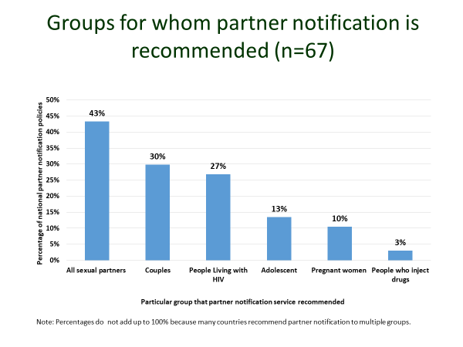
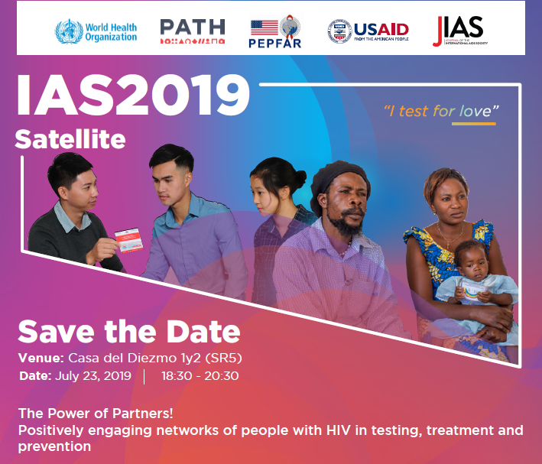
Assisted parter notification services ? Ideal for contraceptive service settings
National PN policy and implementation 2018
>20 countries in AFRO have aPN guidelines
The policy environment is right
aPN increasingly being included in national policies and programme
Increasing successful implementation experience
APN can be offered to women who would like to involve their partners
It must always be voluntary, informed and screening for IPV
Community engagement is key
Listed to community concerns
WHO has held numerous community consultations prior to implementations

Slide 12
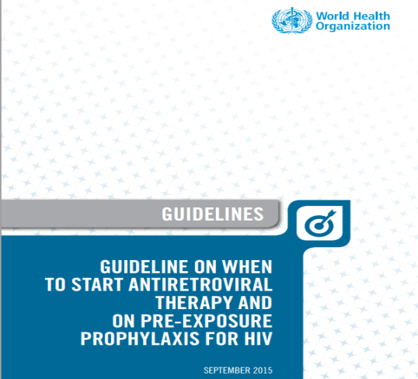
3. PrEP
WHO recommendation for PrEP, 2015
WHO recommend PrEP
Enabling recommendation-not population specific
For people at substantial HIV risk (provisionally defined as HIV incidence > 3 per 100 person–years in the absence of PrEP)
PrEP drugs included in the WHO EML update in 2017
WHO has prequalified PrEP drugs from over 10 generic manufacturers,
Drug already used in ART programmes
Adherence critical, support for continuation needed
(but stopping and starting ok!)
TDF/FTC safe to use during pregnancy and breastfeeding
No drug-drug interactions with hormonal contraception

Slide 13
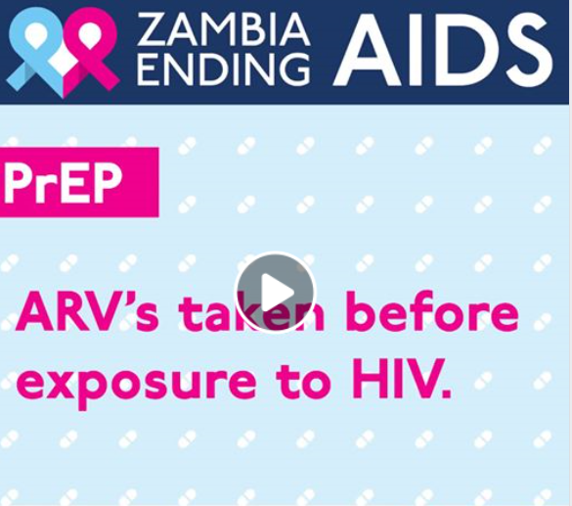
WHO PrEP GL: Specific considerations for women
Limited but increasing real world experience for women
Kenya, South Africa, Lesotho, Zambia
More (and increasing experience from sex worker projects)
How to prioritize implementation
All women – overwhelming and unfeasible
Women at highest risk – often have multiple vulnerabilities
Women who want PrEP – may have self-identified high risk and more motivated to adhere
Balance between offering PrEP to women at substantial risk vs stigmatizing PrEP as something for 'risky women'
Adherence is key
Good adherence in SDC trials and OLE
Poor adherence – commonly observed in other trials, esp. younger women
Understanding poor adherence/continuation and supporting better adherence
Where to offer PrEP for women
ANC clinics, Family planning, STI services, Primary health care, ART clinics
PrEP services should always be part of a comprehensive package, ‘never offer PrEP without offering FP’
https://www.facebook.com/ZambiaEndingAIDS/

Slide 14
Minimum package (WHO and South Africa)
Minimum package for all attending PrEP service
HIV testing (national algorithm)
Syndromic STI diag and Rx
TB screening
PEP
Pregnancy test
Contraception (NDoH package)
Counselling (screen for mental health, alcohol/substance use/mental health
Condoms
Additional minimum package for those choosing PrEP
Creatinine (future plans to review frequency)
Adherence support – peer support
Other services to link to as needed
Laboratory STI diag
Hep B screening & vaccination
Pregnancy test - links for ANC and abortion services
Mental health services
IPV/GBV service
Alcohols/substance use services
CxCa screening and Rx
VMMC
PrEP screening tool/questions
Demand creation
Prevention/ PrEP awareness
HIVST to inc prevention and PrEP info
NDoH web tool for info and service sites

Slide 15
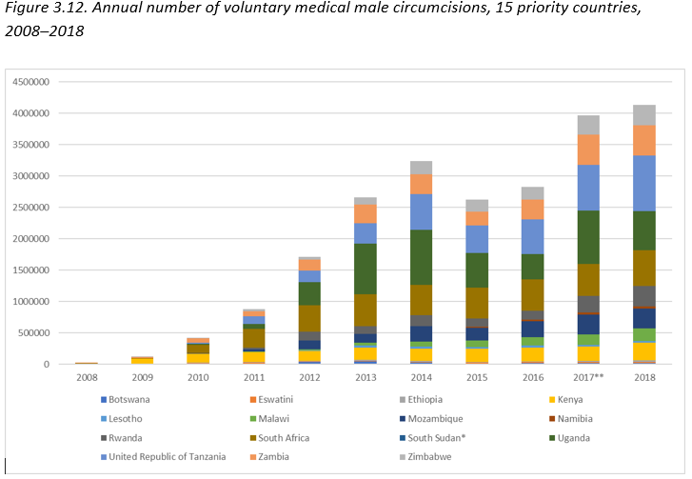
But it is not only about PrEP
Male and female condoms still have an important place
Better male involvement
VMMC needs to be continued to be promoted in parallel

Slide 16
How WHO priotizes PrEP for AGYW inc. in contraception clinics
Epidemiology
geography
Pop density
Women in FP clinc
Individual risk
Previous history of STI
Who wants PrEP
?Risk score
Population group
# sexual parters
? History of GBV
A large %new HIV infections estimated to occur AGYW who had either an STI or >1 partner - providing a straightforward means to offer and set PrEP targets.
Prioritizing PrEP by district, gender and age resulted in lower NNPs increasing the cost-effectiveness of PrEP
While more operationally challenging than screening for STIs, questions about casual partners may identify additional people who would benefit from PrEP.
Mapping Pre-exposure prophylaxis (PrEP) need and benefit for programmatic targeting in three African countries, Shona Dalal 2019
Review and adjust
PrEP for people at substantial HIV risk (≈3 per 100 person years)

Slide 17
Don’t ignore STIs
HIV and STI syndemic in contraceptive services
STI rates rising globally
STI prevalence at baseline in women seeking contraception and during use high in ECHO
STI management in contraception services in LMIC if available is limited or largely syndromic
Most STIs in women are asymptomatic and will not be detected with syndromic approaches
Untreated STIs increase HIV acquisition and transmission
Untreated STIs can lead to pelvic inflammatory disease and infertility in women and lead to serious consequences for babies including stillbirth, low birth-weight and prematurity, sepsis etc
History of STIs (inc HSV2 at baseline) predictive of HIV risk in ECHO (and elsehwere)
We need to do more
Increase attention on STIs
Include better STIs management in contraceptive services, inc using better diagnostics
PoC STI diagnostic would not only enable better STI management, but could prioritize PrEP offer
Advocate for research priorities and funding
July 2019 WHO PrEP and STI technical update

Slide 18
So following ECHO what could we do now and how could we prioritize
 | Incidence
 | High Eg SA, Eswatini | Medium Eg Zambia | Low eg India
HIV testing Inc HIVST | √ always | Based on epidemiology | ? X routine ?focused
Voluntary partner testing | √ for all | √ for women with HIV | √ for women with HIV
Condoms | √ | √ | √
STI management | √ | √ | √
PrEP | √ | ?√ - but focus | ?X – but individual request eg SDC
How we can make this happen
WCA

Slide 19
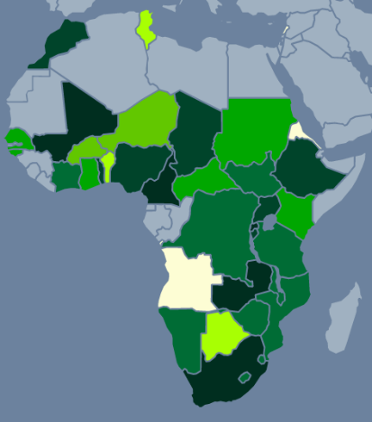
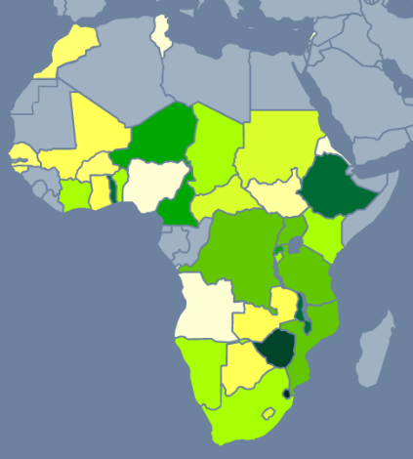
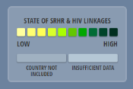
We must to better
Targets and action on SRH-HIV linkages urgently needed
HIV strategy – level of SRHR linkages
SRHR strategy – level of HIV linkages

Slide 20
Time for action
Women, want, need and deserve more HIV prevention access and choice
Women who seek contraception in high HIV burden countries should be able to
learn their HIV status
access treatment easily
have a range of choices to protect themselves from HIV
STIs in women are often asymptomatic and current syndromic approaches may not be adequate. A push for better diagnosis and treatment of STIs is needed, inc Cervical Cancer
We need to act now.
Listen to women, involve women
Fast track national policies and overcome regulatory barriers (HIVST, aPN, PrEP)
Make national commitments, set testing and prevention targets, commit to training providers

